Slide 1
Internationalization of higher education in Morocco
Ahmed FAHLI
Hassan 1 University Morocco
www.uh1.ac.ma

Slide 2
SUMMARY
1
Overview of the Moroccan higher education
2
Internationalization of H.E : Purposes, Strategies ,and Mechanisms
3
Towards a modernization to manage the internationalization of H.E in Morocco

Slide 3
SOMMAIRE
1
Overview of the Moroccan higher education
1.1
1.1
Components of the system
1.2
1.2
Potential training
1.3
1.3
Key figures
1.4
1.4
Training offer
1.5
1.5
Foreign students in Morocco

Slide 4
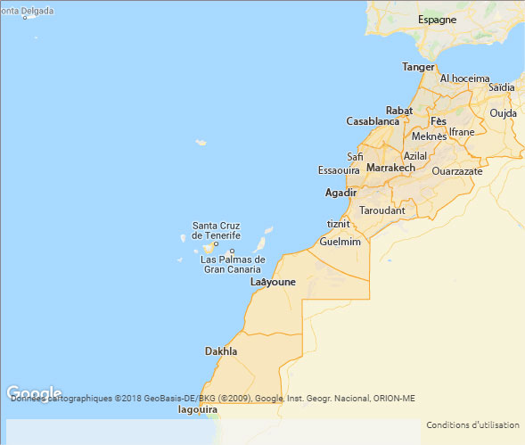
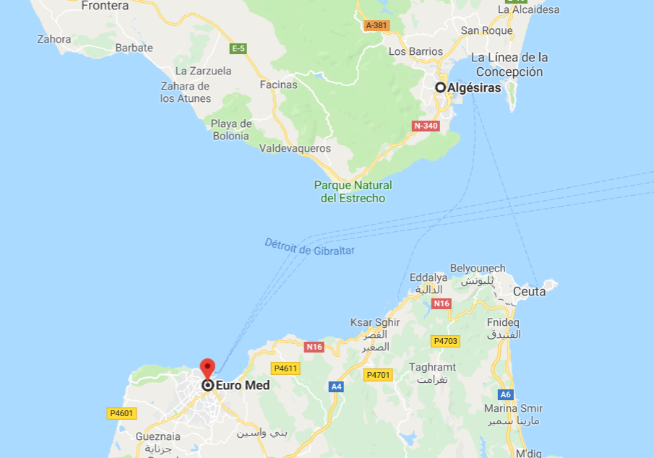
Morocco is 7 hours direct flight from new work Casablanca.
My university is 30 minutes from the aereport

Slide 5
1. Overview of the higher education system
1.1 Components of the system
Public higher education
Creations under a partnership
Private Higher Education
Institues not under universities
Universities and Institutes
Universities and Institutes
Universities
Under the tutelage of the ministry of Higher Education, scientific research and training
Under the administrative and financial tutelage of technical ministries
Non-profit foundations, created as part of the dynamics of internationalization of higher education
Created in a private initiative
Under the pedagogical authority of the ministry of Higher Education, scientific research and training
Under the pedagogical authority of the ministry of Higher Education, scientific research and training
Under the pedagogical authority of the ministry of Higher Education, scientific research and training
.

Slide 6
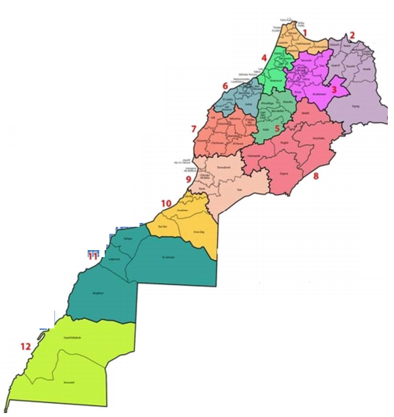
1. Overview of the higher education system
13 _{Public Universities}
1
Public University with private management
Univ. Al Quaraouiyine
Univ. Mohammed V -Rabat
Univ. Al Akhawayn
Univ. Hassan II- Casablanca
5
Universities as part of the Partnership (16 institutions)
Univ. Sidi Mohammed Ben Abdellah- Fès
Engineering Schools created under the Partnership:
Ecole Centrale de Casablanca
Institut International des Sciences
Appliquées Euro-Méditerranée
Institut Méditerranéen de Logistique et
des Transports Tetouan
Univ. Cadi Ayyad- Marrakech
3
Univ. Mohammed Premier- Oujda
Univ. Abdelamlek Essaâdi- Tétouan
Univ. Chouaïb Doukkali -El Jadida
Univ. Moulay Ismaïl- Meknès
5
Private Universities
₁₃₄
University institutions(Public) .
Univ. Hassan Premier -Settat
Univ. Ibn Tofaïl- Kénitra
Univ. Ibn Zohr- Agadir
Univ. Sultan Moulay Slimane- Beni Mellal
₇₇
Training institutes of executive senior
184
_{Private institutes}

Slide 7
1. Overview of the higher education system
Moroccan population
34 millions
2018-2019
876005 in 49.4% are women
Overall student population (without PF)
Public higher education, University
820.430
Private higher education and PPP
45.174
Higher education not under universities
35.695
University graduates (2017-2018)
111.843
Overall effective of permanent Professors
19677

Slide 8
1. Overview of the higher education system
Higher education in Morocco is an area open to investment. the state offers tax advantages and facilitates the installation of private universities or PP.
Nearly 2000 accredited programs at universities and
ENRPU
Public sector
Nearly 400 accredited programs in higher education
Private Sector

Slide 9
1. Overview of the higher education system
Morocco: Land of welcoming foreign students
More than 19.157 foreign students enrolled in different public and private higher education institutions (5000 students for the year 2017-2018)
Breakdown of new foreign students by origin
Morocco welcomes more than 4000 new foreign students per year;
More than 60% of foreign students come from African countries. 95% receive a scholarship from the Moroccan government
350 places are reserved to African students in student accommodations in addition to the international student accommodation ( reserved to non-Moroccan students , more than 850 places).
The majority (82%) come from Africa, about 10% from Asia and 5% from Europe. 9,000 of them benefited from a Moroccan scholarship.

Slide 10
AMCI – Agence Marocaine De Coopération Internationale www.amci.ma
The flow of foreign students is managed by
the Moroccan agency of international cooperation

Slide 11
1. Overview of the higher education system
Morocco: Land of welcoming foreign students
Morocco occupies the 8th position; among the top 10 countries that welcome the most African students.
Morocco is among the top 5 student destinations
37% of them are studying in institutions with regulated access (Medicine and Pharmacy, Dental Medicine, Science and Technology, Engineering Sciences, Commerce and Management, Technology and Translation).
Morocco, regional pole of education and scientific research

Slide 12
2
Internationalization of the Moroccan higher education
2.1
2.1
Aims
2.2
2.2
Strategies
2.3
2.3
Support mechanisms

Slide 13
2. Internationalization of H.E
2.1 Aims
Adoption of the European system (LMD) 2002-2019.
Recently, we begin the adoption
of Bacheler as a Anglo Saxon system

Slide 14
2. Internationalization of H.E : Strategies
Development of the international cooperation strategy
Project 1: Focusing and Strengthening Current Cooperation Programs with Foreign Countries
Project 2: Create of new partnerships in the fields of higher education and scientific research
Project 3: Consolidation of the cooperation with the regional environment in the framework of south-south cooperation
Project 4: Strengthening the mobility of Moroccan students and professors

Slide 15
2. Internationalization of H.E : Strategies
-Strategic Vision of the Reform 2015-2030-
Strategic axis II:
Improve the quality of higher education and adapt it to meet the needs of development and the labor market
Project 8:
Strengthening Morocco's position as a regional pole of higher education and scientific research
Projet 9:
Consolidation of international cooperation in the field of scientific research and technology
Actions:
Actions:
Pursue institution building projects opened to the international
Develop new cooperation projects with foreign partners taking into account the national priorities of each of one, in the field of higher education and scientific research;
Set up a strategy to communicate these institutions internationally.
Evaluate the different cooperation programs;
Ensure the effective participation of Moroccan institutions in the various cooperation programs through : continuing training of specialized in developing and managing cooperation projects, reinforcement of focal points, etc.)
Set up mechanisms to ensure the implementation of cooperation projects;
pursue and coordinate the participation of Moroccan institutions in the activities of international organizations.

Slide 16
2. Internationalization of H.E: support mechanisms
The adoption of the LMD System (Bologna Process) has allowed our higher education system to be more readable in the European area and facilitated increasing the mobility of students, researchers and Professors.
Cooperation with several countries and international organizations: European, American, African, Arab and Asian.
Cooperation agreements: a dense and diversified interuniversity cooperation: More than 2873 agreements concluded between Moroccan universities and their foreign counterparts; 65% with francophone universities
Set up of networks: leverage to participate into international programs
Active participation of Moroccan universities in calls for projects in training and research (Erasmus +, H2020 ...).
Student, professor , and Training Mobility
Joint Resource Mobilization
Development of double degrees and cotutelle of thesis with partner institutions

Slide 17
Prestigious universities and institutions are starting to settle in Morocco:
1- to receive Moroccan students who can pay for their studies.
2- Receive students from Africa or neighboring countries who can not go to Europe. for various reasons

Slide 18
Creation of several universities and institutions with international nature in collaboration with foreign institutions:
Al Akhawayn University in Ifrane ;
International University in Rabat ;
Euro-Mediterranean University of Fez in partnership with the French School Group of Engineering Schools INSA, Polytechnic University of Catalonia, Porto University in Portugal and Polytechnic University of Turin (Italy)
Mohammed VI Polytechnic University in Benguerir in partnership with: MIT in the United States and Mines ParisTech;
Mohammed VI University of Health Sciences - Casablanca;
Abulcasis International University of Health Sciences - Rabat;
INSA International;
The 'Ecole Centrale' of Casablanca in collaboration with the 'Ecole Centrale' of Paris. ;
International Institute of Technology (in progress): in partnership with IUT - France IUT International;
Mediterranean Institute of Logistics and Transport in Tetouan with the 'École des ponts' ParisTech

Slide 19
The internationalization of the education system is a phenomenon that is needed all over the world:
1- The socio-political globalization experienced by the world in recent years
2- The disappearance of borders between states through the use of new communication technology
3- the emergence of a new teaching method: Distance Learning - MOOCs

Slide 20
End
The internationalization of higher education is no l a luxury but a need to ensure the development of countries and the development of peoples.
those because there is now a globalization of problems too . as

Slide 21
- global warming
- south-north immigration problem
- Numeric fraction
-impact of social networks
- the aspirations of our young people for a better life

Slide 22
https://youtu.be/se957OMoU8k

